Slide 1

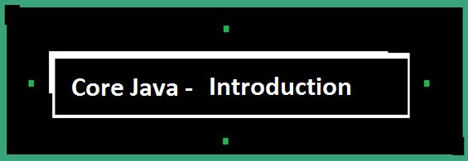


Slide 2


Real World
Translator
Japanese
French

Slide 3
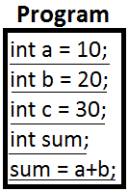

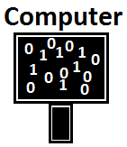








Program
Set of Instructions for a computer to perform a task or operation

Slide 4

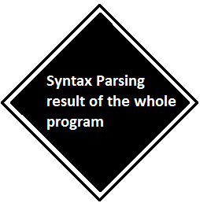
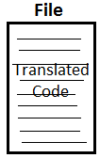
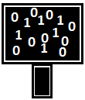
Compiler
Failure
Success

Slide 5
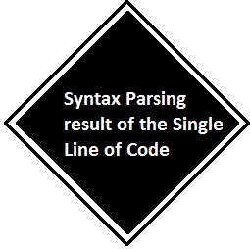

Interpreter
Failure
Success

Slide 6
Compiler vs Interpreter
Compiler
Interpreter
- Syntax Parsing of entire input File
- Errors will be thrown for entire input file
- A File is Generated for a Successful compilation
- Execution is faster
- Efficient for huge set of programs
- Syntax Parsing of single line of the input File
- Errors will be thrown for a particular line of code
- A file is not generated for a successful interpretation
- Execution is slower
- Efficient for Small Pieces of code

Slide 7
Program Development
Coding – Writing Set of Instructions (i.e Program) according to Java Language Rules and regulations is called as Coding w.r.t Java
  Note:: All Java Programs should be saved with .java extension
Compilation – Converting the Java Program written in High Level Language into byte codes by using javac Compiler is called compilation w.r.t Java.
  Note:: The Byte codes will be stored in .class file
  Command :: javac Filename.java
Execution – Converting the byte codes of a .class file into computer understandable instructions using JVM( Java Virtual Machine) is called as execution w.r.t Java
  Note:: JVM is a Interpreter.

Slide 8
Thank You !!!

